Slide 1
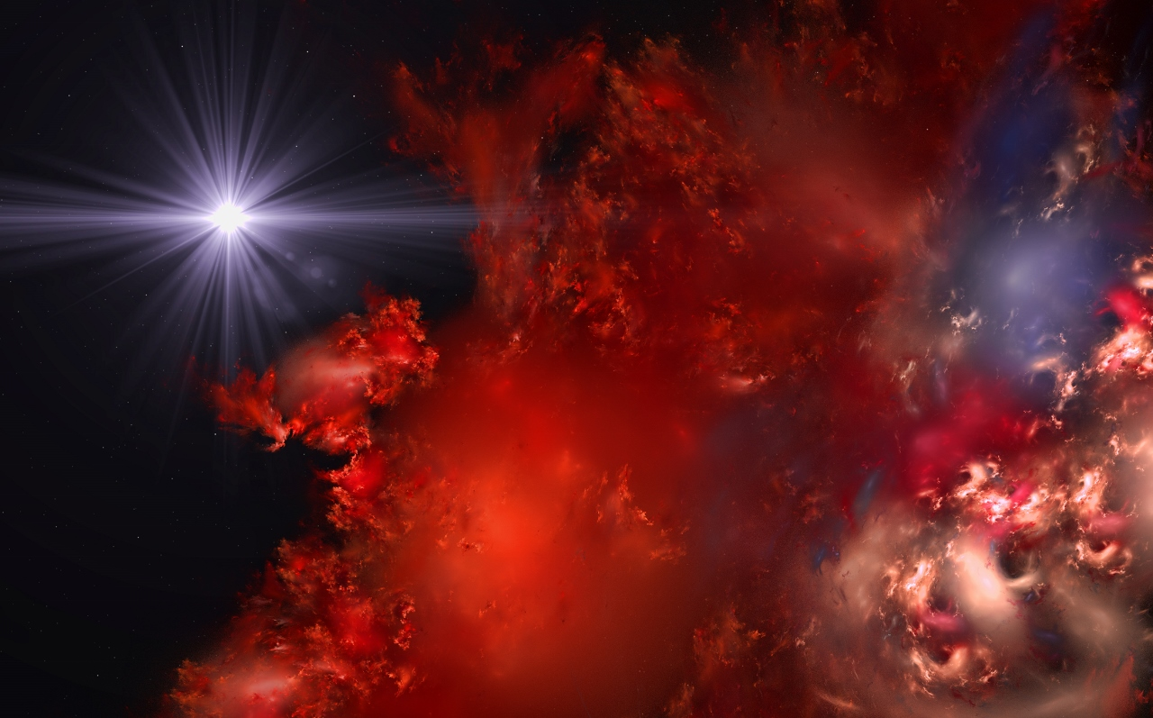
A good Sci-Fi author takes you to an alien world; a great Sci-Fi author leaves you there.

